Slide 1
Jacobson TCP/Ip heder COMPRESION
Gani ,Md. Osman
Id : 14-25538-1
Sec : G

Slide 2
What is Jacobson Compression?
A protocol that allows for the reduction of the TCP header combination to be reduced from 40 bytes down to as little as 3 or 4 bytes after the initial connection
Laymen Terms: Packets are made smaller by sending only the data that has changed. Smaller
packets allow us to transmit more data in given time

Slide 3
What’s the purpose
Designed for slow network
Min : 300 bits per second
Max : 19200 bits per second(19.2 kbps)
Reucing the header size allows for more useful data to be transmitted in a given time

Slide 4
Strength :
Simple
Cuts total data in the header to about 1/10 (40 bytes down to 3-16 max bytes)
Higher the bps higher the efficiency
All info is sent in 120 us (based on 64 kbps connection)
Weakness :
Compression/decomprassion overhead introduced
Error recovery option must be replaced (checksum)

Slide 5
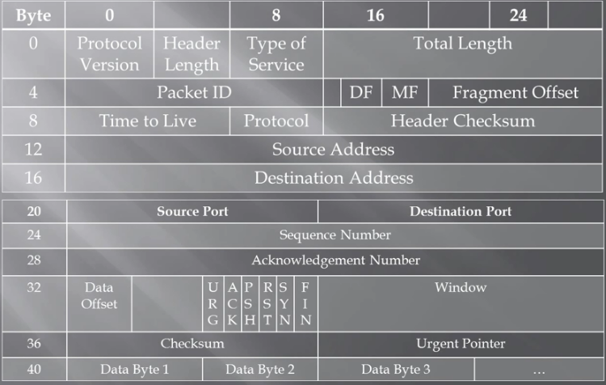
TCP/IP Header

Slide 6
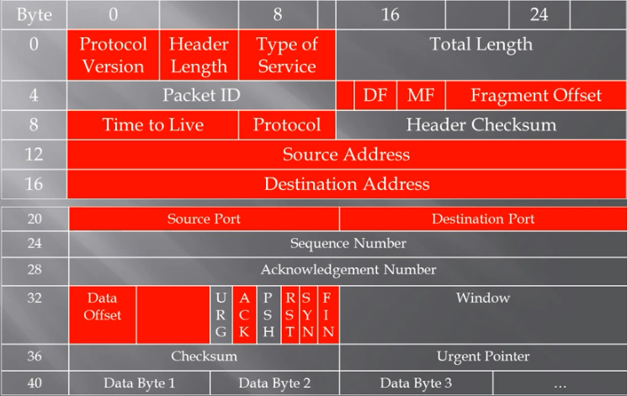
TCP/IP header

Slide 7
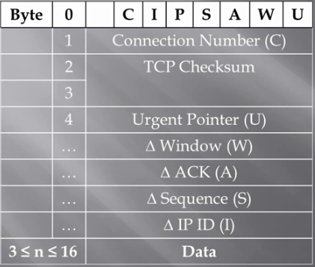
Connection Number : Used to locate the save copy of the last packet for this TCP connection.
TCP checksum : inclusded so that end to end data integrity check will still be valid
Urgent Pointer :This is sent if URG is set.

Slide 8
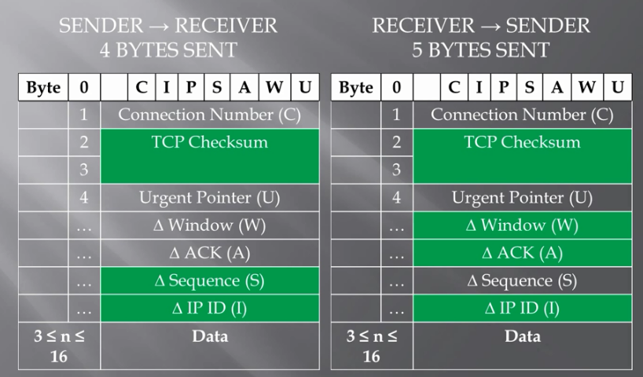

Slide 9
Reference :
1. http://tools.ietf.org/pdf/rfc1144
2.http://www.javvin.com/protocolVAN.html

